Slide 1
Lab. 06
Logic Design Lab.
Spring 2018
Prof. Chang-Gun Lee
(cglee@snu.ac.kr)
TA. WonJae Jang
TA. Wonseok Lee
TA. Alena Kazakova
TA. Dongwan Kang
(ta@rubis.snu.ac.kr)

Slide 2
Contents
FPGA
SNU Logic Design Board
Sample Implementation
Lab

Slide 3
FPGA

Slide 4
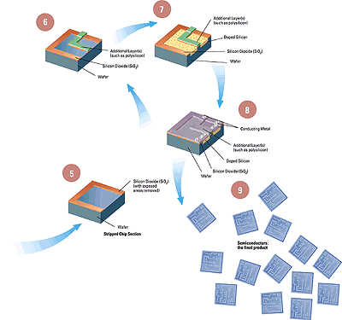

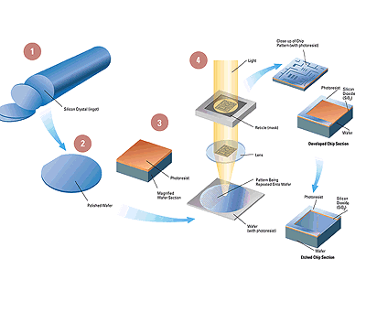

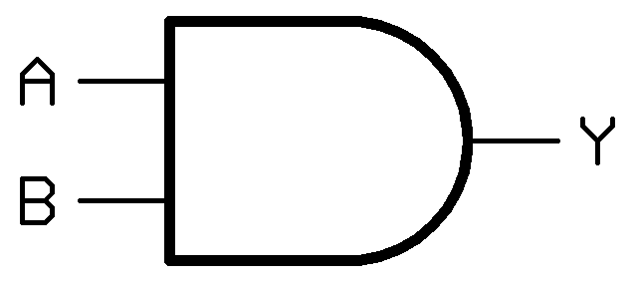


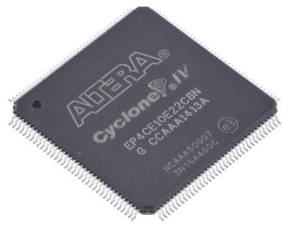
What is FPGA?
without FPGA
with FPGA
FPGA

Slide 5
SNU Logic Design Board

Slide 6
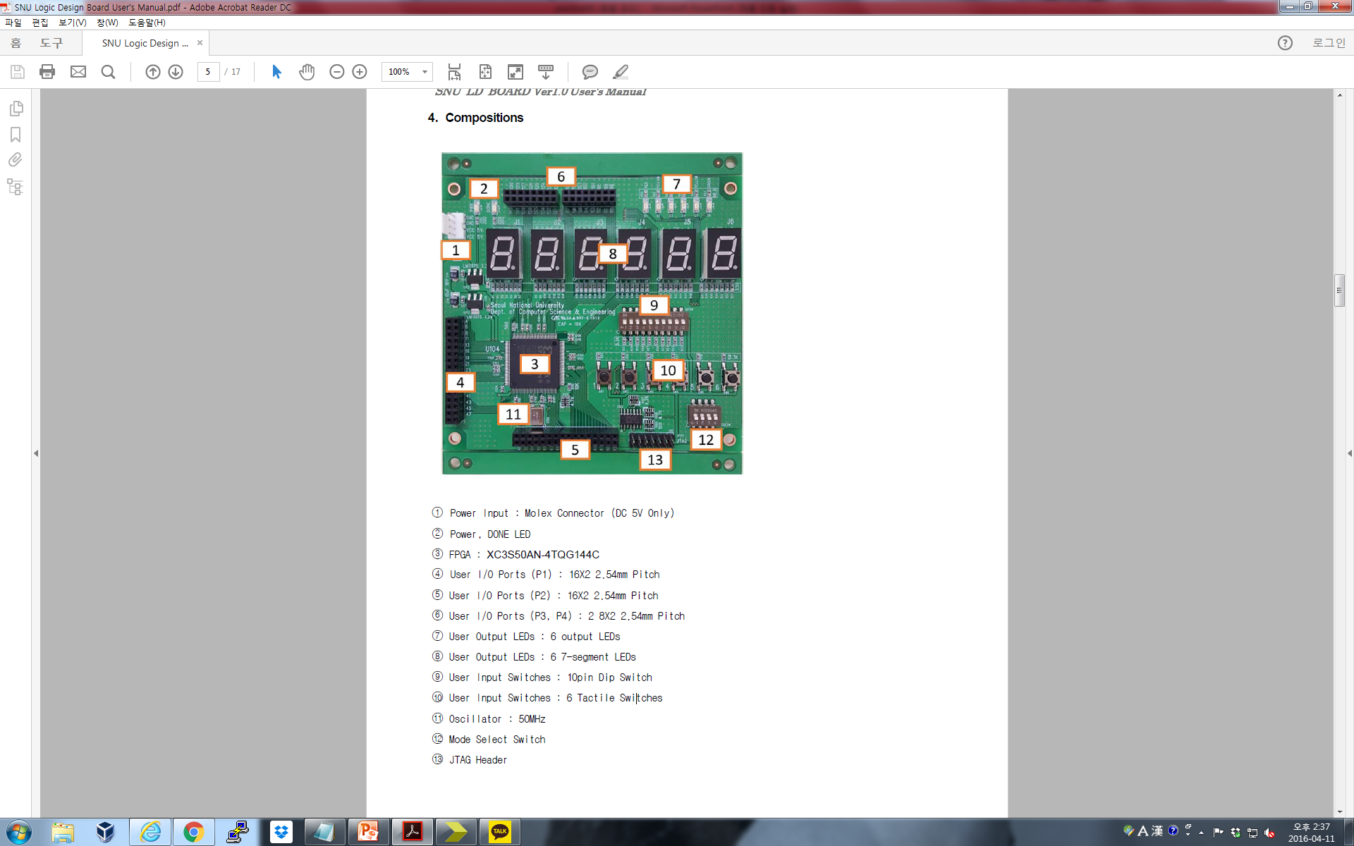
SNU Logic Design Board

Slide 7
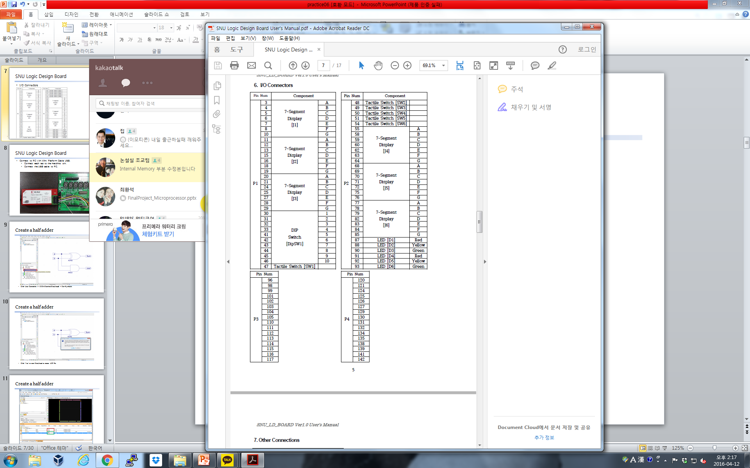
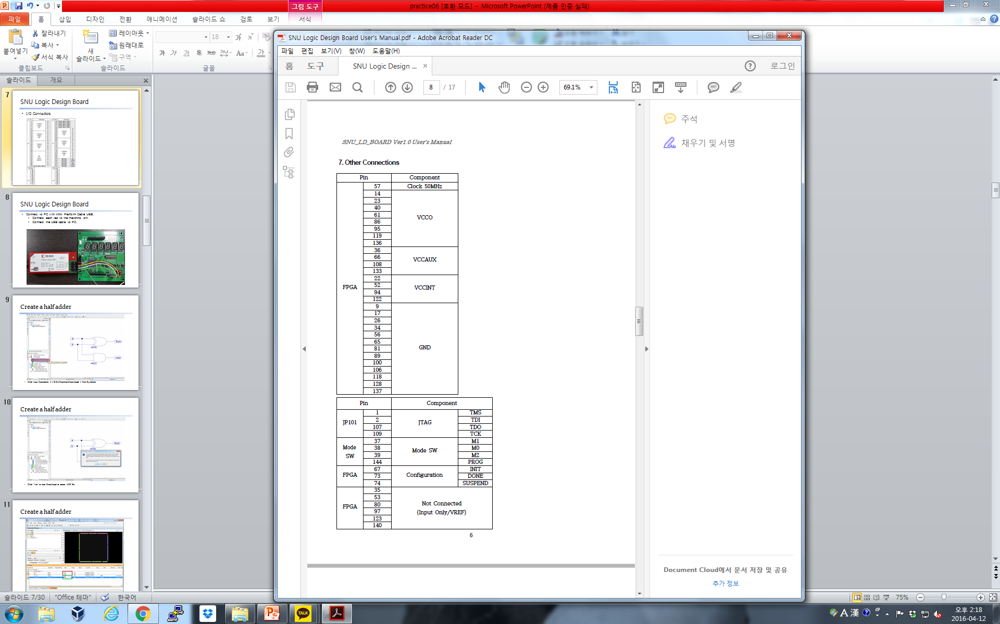
SNU Logic Design Board
I/O Connectors

Slide 8
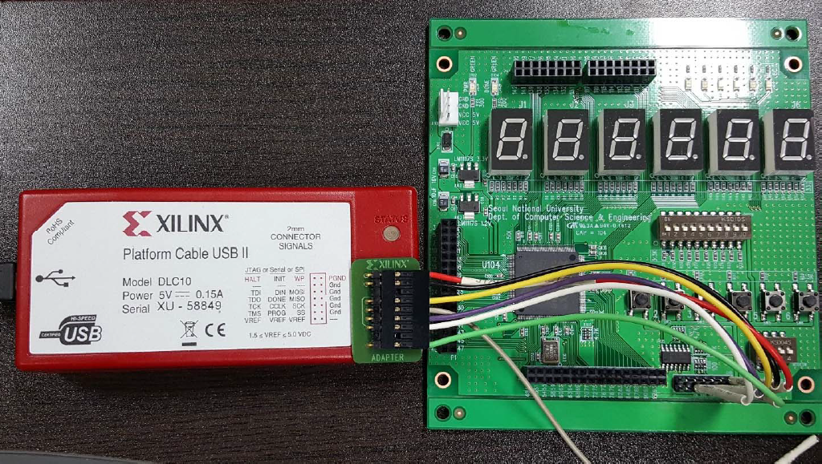
SNU Logic Design Board
Connect to PC with Xilinx Platform Cable USB
HALT/RST Pin(Gray pin) not used.
Make sure both board and USB are powered on.

Slide 9
Sample Implementation

Slide 10
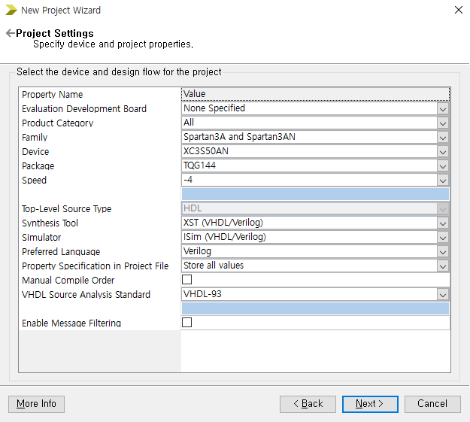
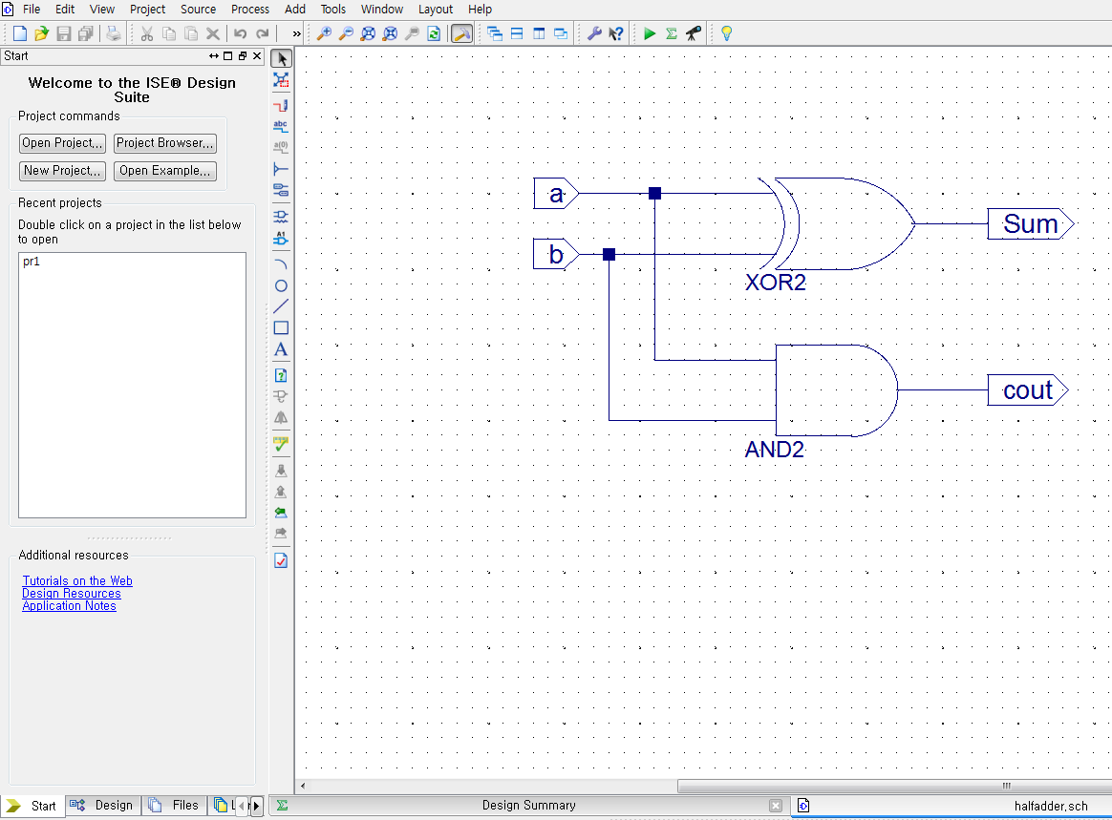
Sample Implementation
Create new project, build a half adder schematic.
For detailed settings, refer to guidelines in Lab03.

Slide 11
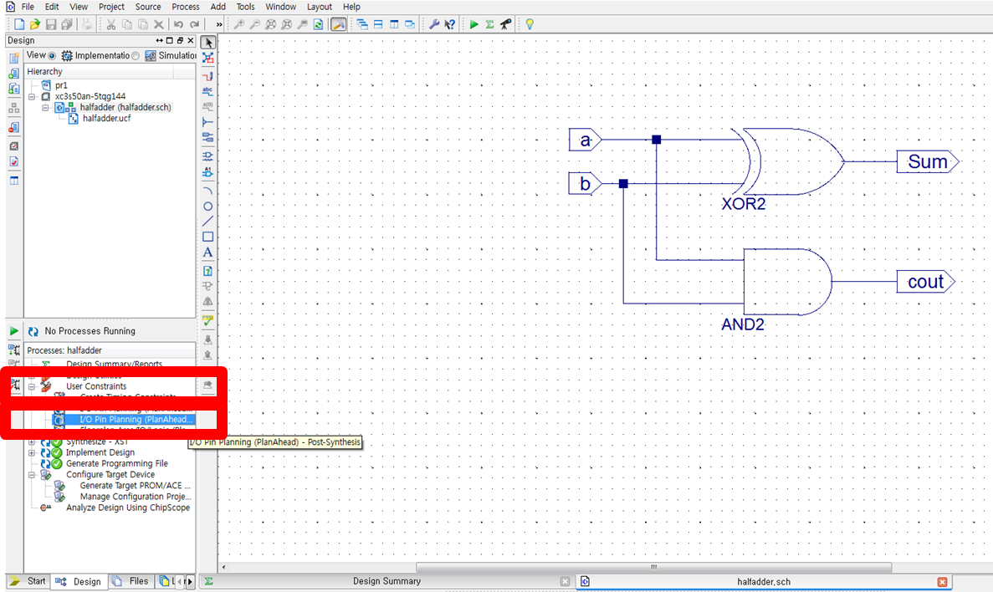
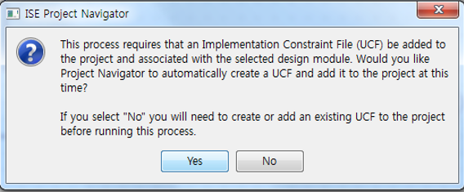
Sample Implementation
Design tab > User Constraints > I/O Pin Planning(PlanAhead) – Post-Synthesis.
Click ‘Yes’ to start PlanAhead, and to create an UCF file.

Slide 12
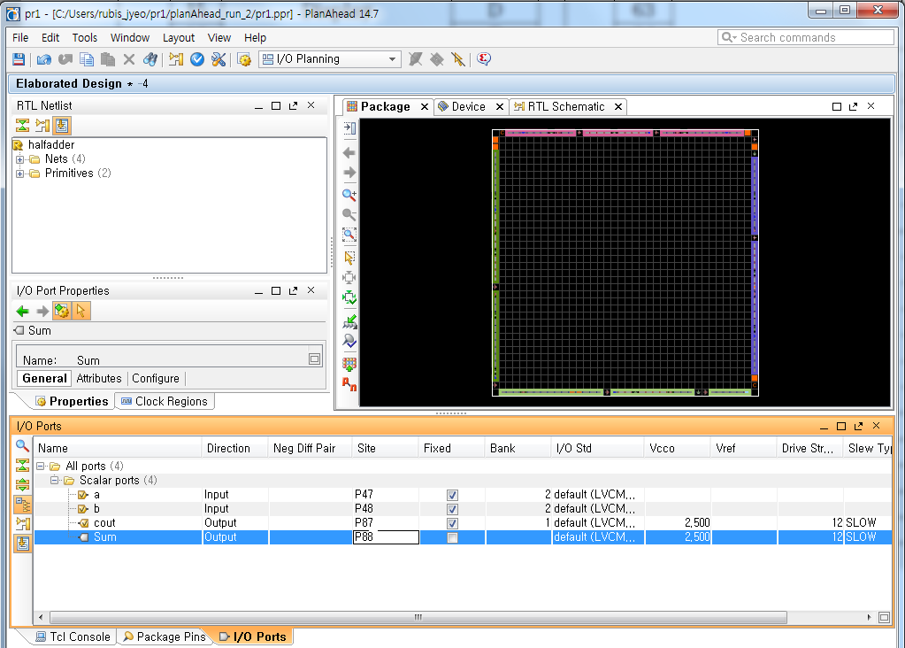
Sample Implementation
Assign I/O pins for the half adder
RUBIS

Slide 13
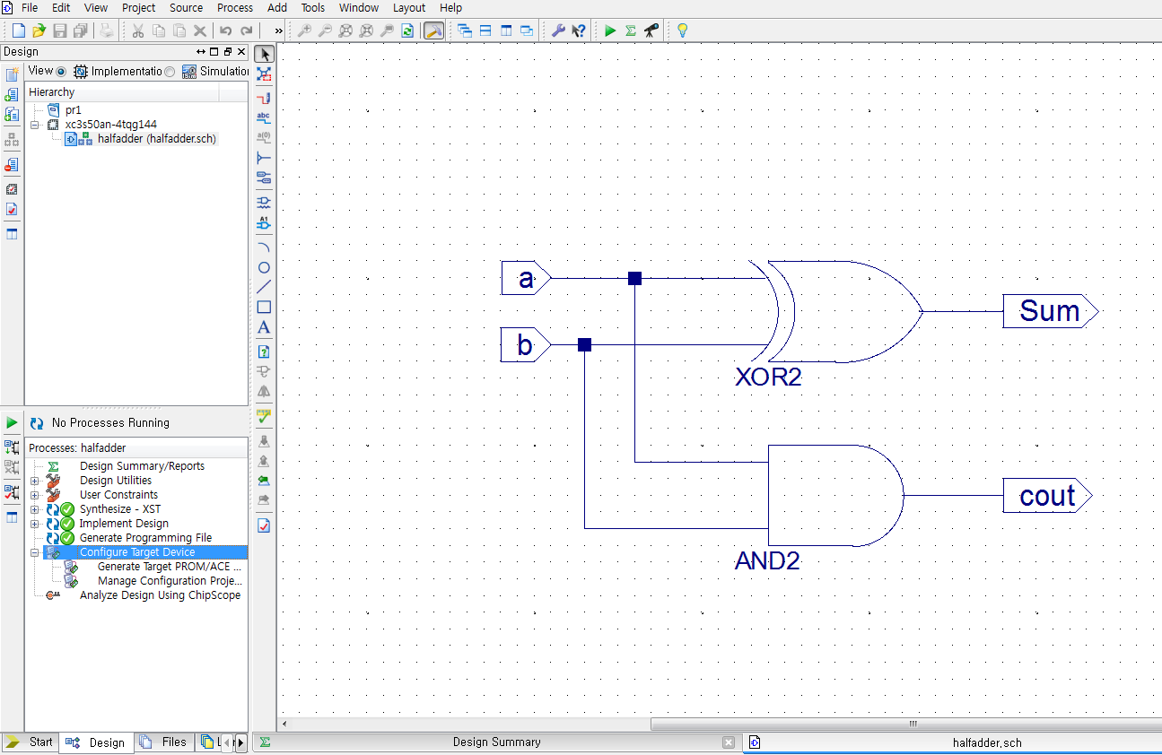
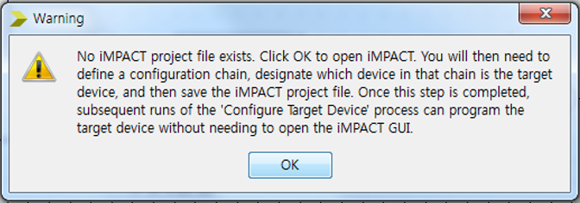
Sample Implementation
Design tab > double click Configure Target Device
Click OK to create an iMPACT file.
RUBIS

Slide 14
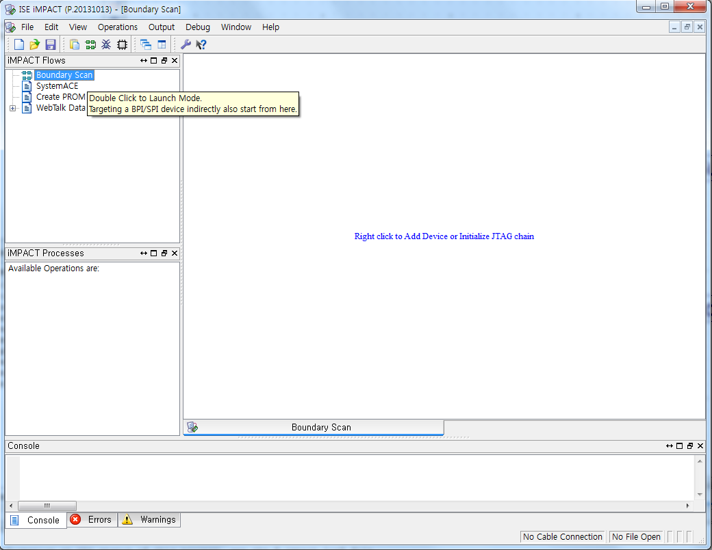
Sample Implementation
Double click “Boundary Scan”.
RUBIS

Slide 15
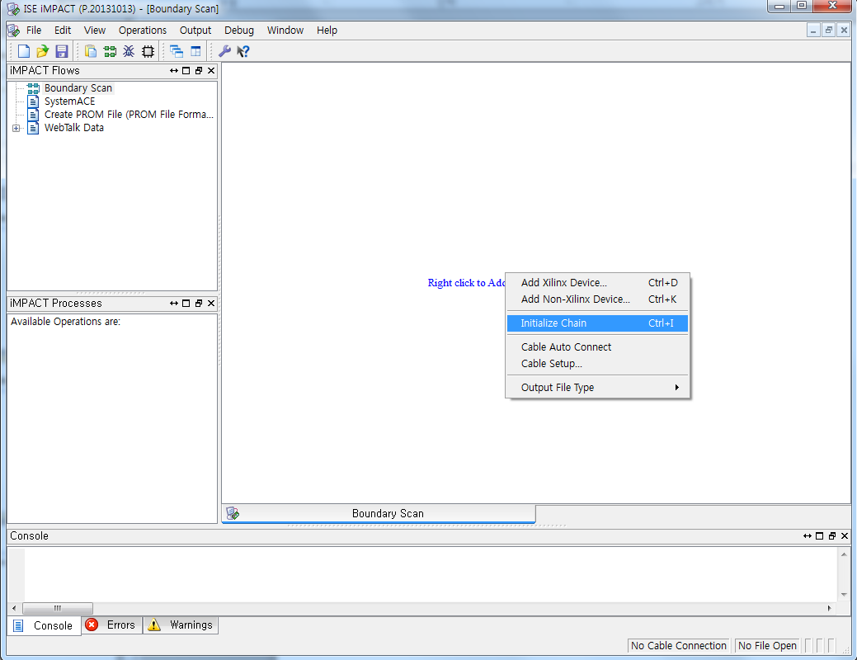
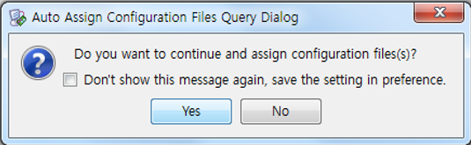
Sample Implementation
Right click on the right window > click ‘Initialize Chain’.
RUBIS

Slide 16
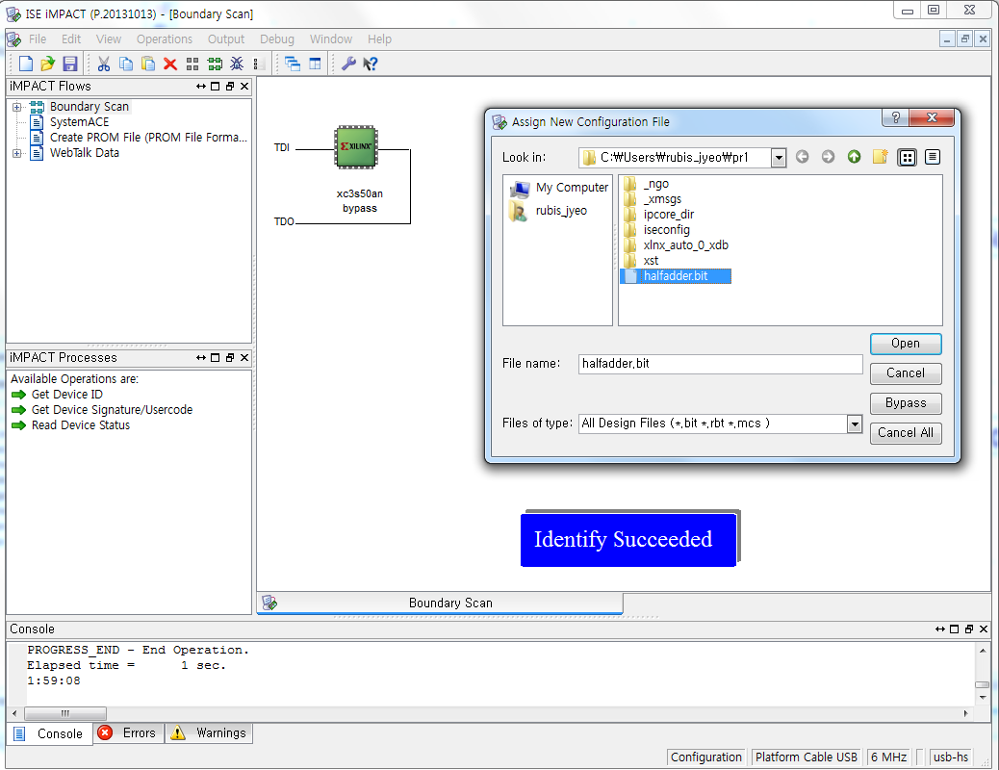
Sample Implementation
Choose the schematic source you’ve written.
RUBIS

Slide 17
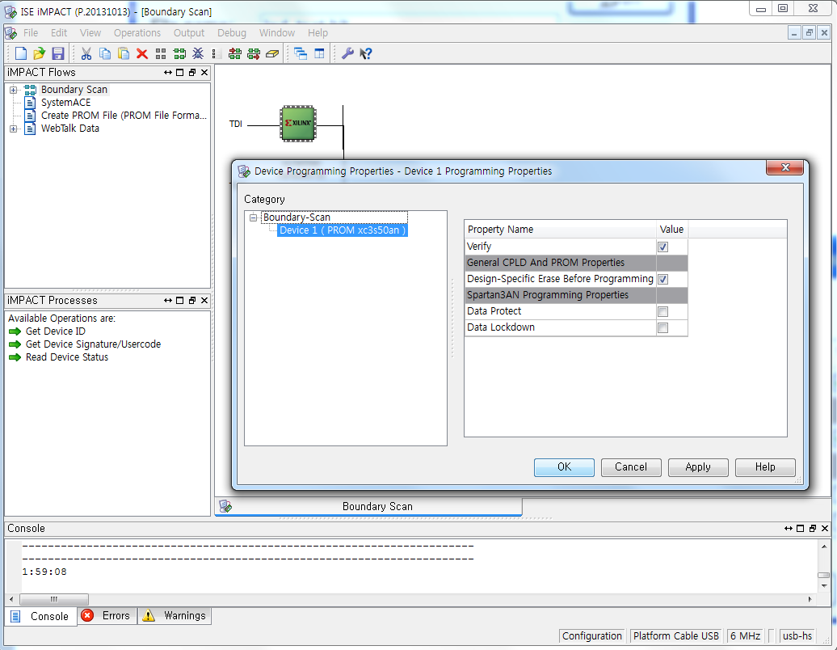
Sample Implementation
Check settings > ‘OK’.
RUBIS

Slide 18
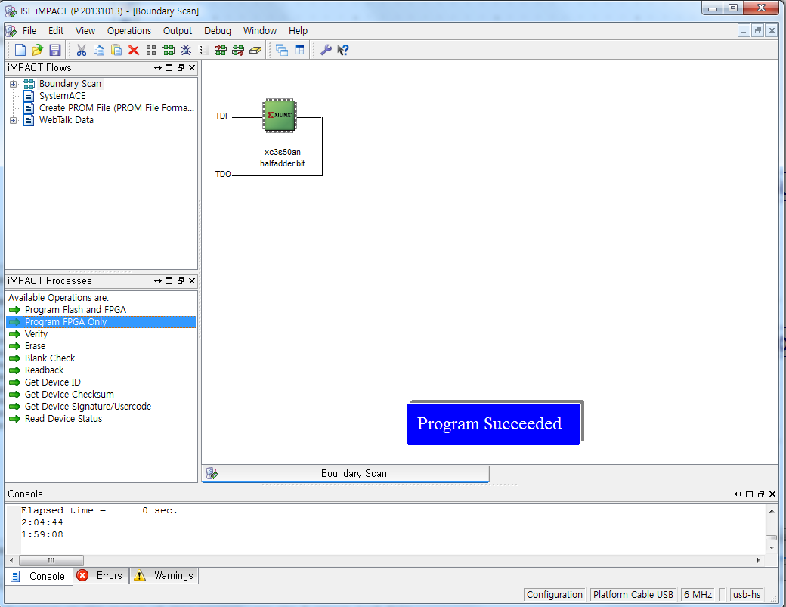
Sample Implementation
Program FPGA Only > Program Succeeded
RUBIS

Slide 19
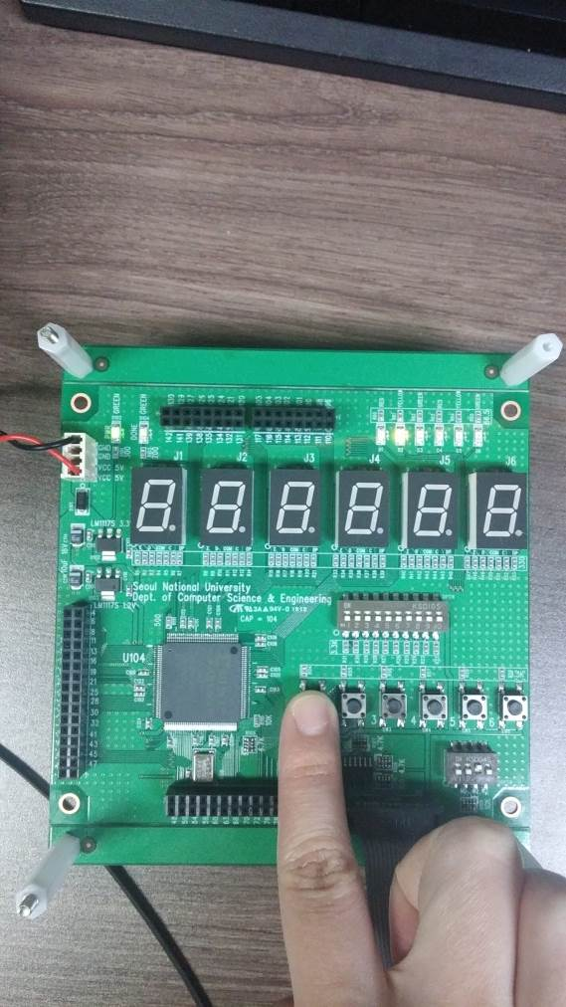
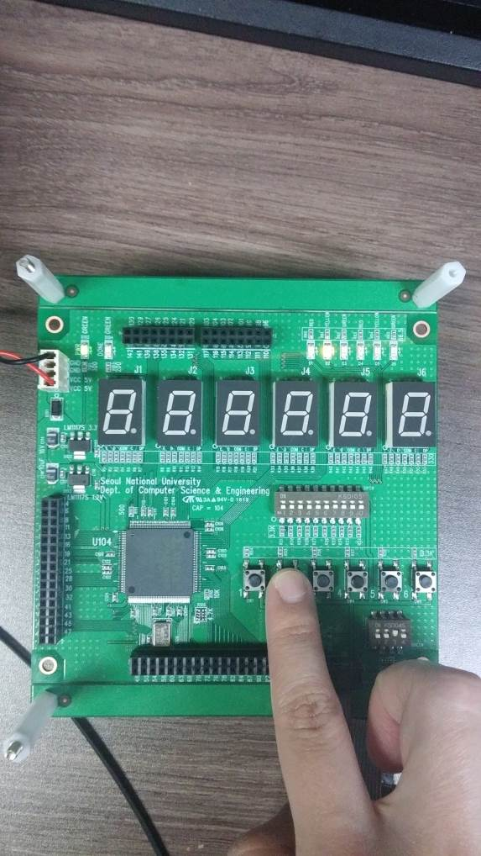
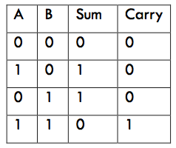
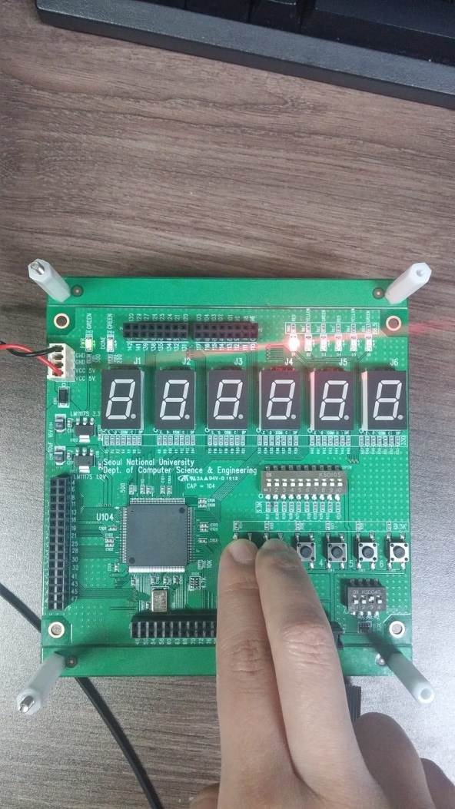
Sample Implementation
Debug using assigned I/O ports. (This case, LEDs and tactile SWs.)
RUBIS

Slide 20
LAB

Slide 21
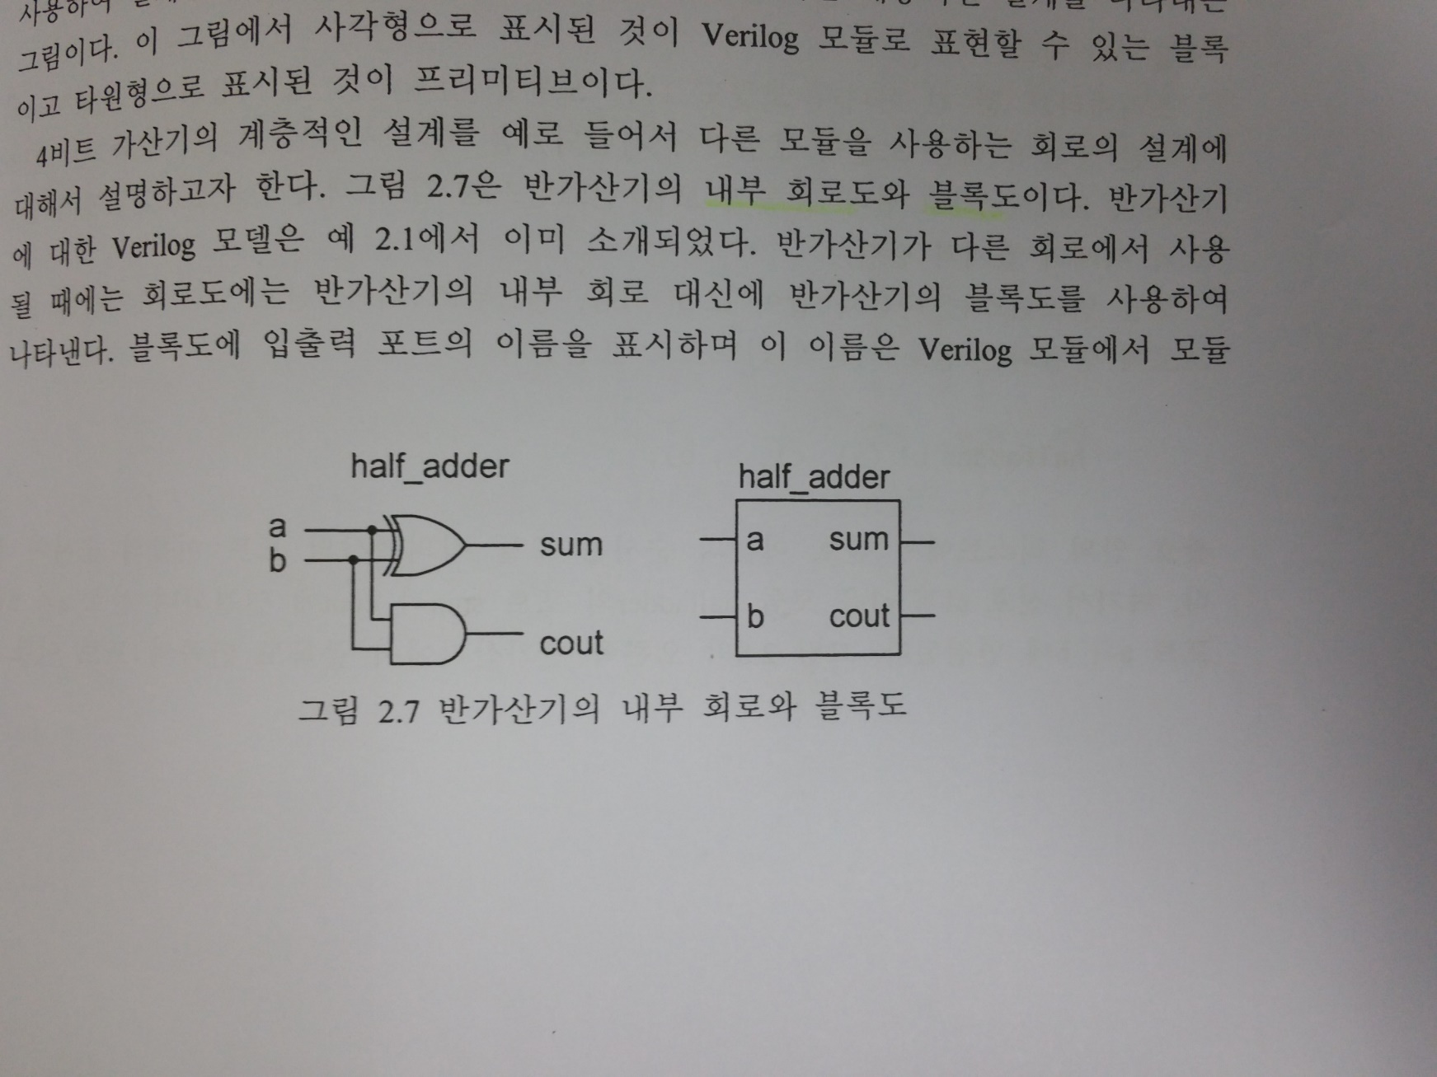
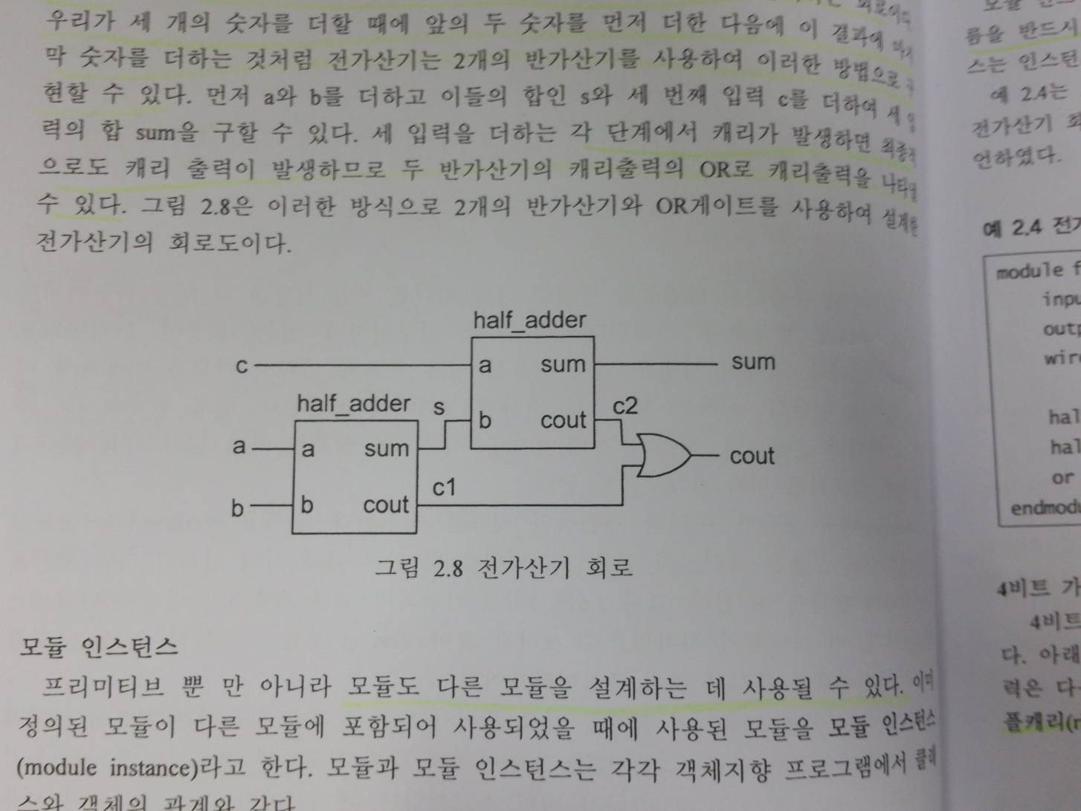
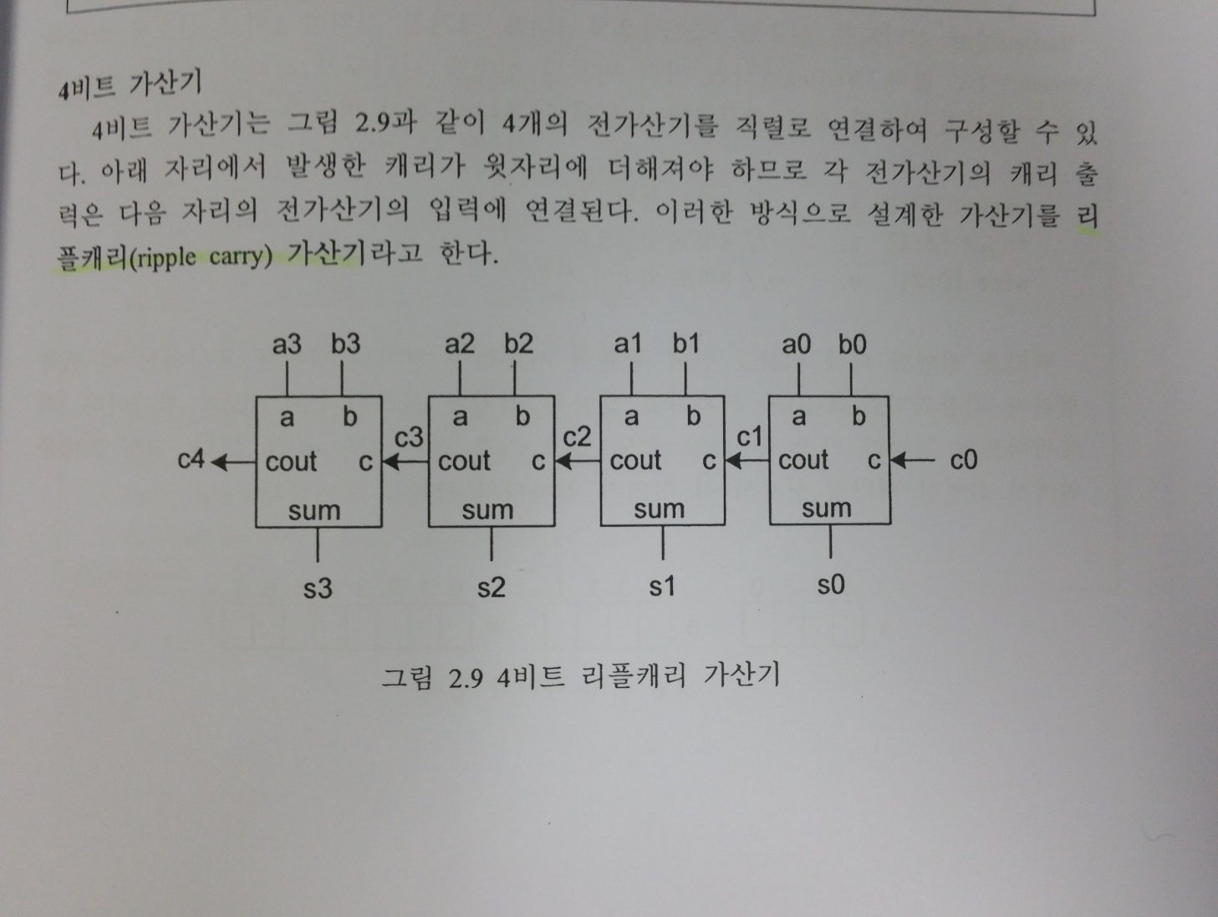
Today
(1) Implement ripple-carry adder, shown below, in Verilog, (2) and program it on the FPGA board.
Hint: 5 inputs (tactile SWs), 3 outputs (LEDs)
(a) Half Adder
(b) Full Adder
(c) Ripple Carry Adder

Slide 22
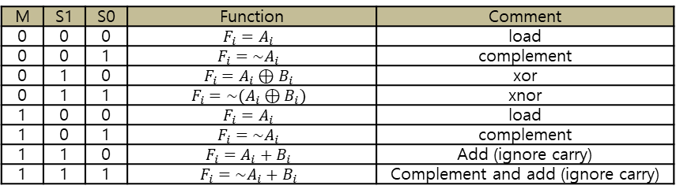
Homework
1-bit Arithmetic Logic Unit (ALU).
(1) Follow specification(a). Implement in Verilog. (M, S1, S0) are control inputs, (Ai, Bi) are data inputs, and (Fi) is outputs.
(2) Simulate all possible outputs using Verilog test bench.
M | S1 | S0 | Function | Comment
0 | 0 | 0 | $$F_{i}=A_{i}$$ | load
0 | 0 | 1 | $$F_{i}={\sim A}_{i}$$ | complement
0 | 1 | 0 | $$F_{i}=A_{i}⊕B_{i}$$ | xor
0 | 1 | 1 | $$F_{i}=\sim (A_{i}⊕B_{i})$$ | xnor
1 | 0 | 0 | $$F_{i}=A_{i}$$ | load
1 | 0 | 1 | $$F_{i}={\sim A}_{i}$$ | complement
1 | 1 | 0 | $$F_{i}=A_{i}+B_{i}$$ | Add (ignore carry)
1 | 1 | 1 | $$F_{i}=\sim A_{i}+B_{i}$$ | Complement and add (ignore carry)
(a) specification
RUBIS
22

